Slide 1


BANK MANAGEMENT
SYSTEM
Submitted by: Ravina R Kumaras
Batch number : 2021-6258
Enrollment number:EBEON1121457568

Slide 2
INTRODUCTION
The main objective of bank management is to build organic and optimal system interaction between the elements of banking mechanism with a view to profit.
The system provides the access to the customer to create an account,Search Accounts,withdraw,deposite etc.
This java program has following main menus:
Display All
Search By Account
Deposit
Withdrawal
Exit
Initially, we will add some N customers to the bank and then we can display all account details using menu 1, menu 2 is used to search the bank account, menu 3 is used to deposit money in particular account, menu 4 is used to manager withdrawal and menu 5 is used to exit from the program.

Slide 3
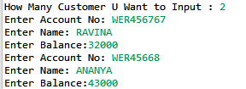
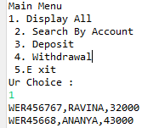
OUTPUT sCREENSHORTS
Create An Account
Display

Slide 4
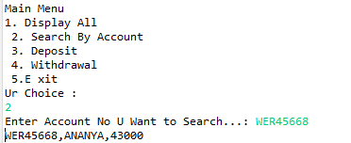
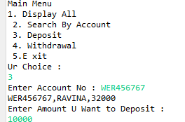
Search by account
Deposite

Slide 5
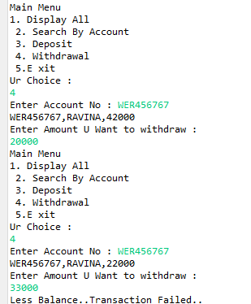
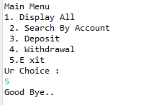
Withdrawal
Exit

Slide 6

THANK YOU

